Slide 1


Web Hosting using nginx
Hosting a website on nginx server using aws ec2-instance
Presented By:-
Lakshya Soni

Slide 2
What Is Aws?
AWS stands for Amazon Web Services, which is a subsidiary of Amazon providing a comprehensive suite of cloud computing services. AWS offers a wide range of infrastructure and application services that enable businesses and individuals to build and run applications, store data, and perform various tasks in the cloud.
Main services of Aws are:
Compute Services
Storage Services

Slide 3
What is nginx ?
NGINX is open source software for web serving, reverse proxying, caching, load balancing, media streaming, and more. It started out as a web server designed for maximum performance and stability. In addition to its HTTP server capabilities, NGINX can also function as a proxy server for email (IMAP, POP3, and SMTP) and a reverse proxy and load balancer for HTTP, TCP, and UDP servers.

Slide 4
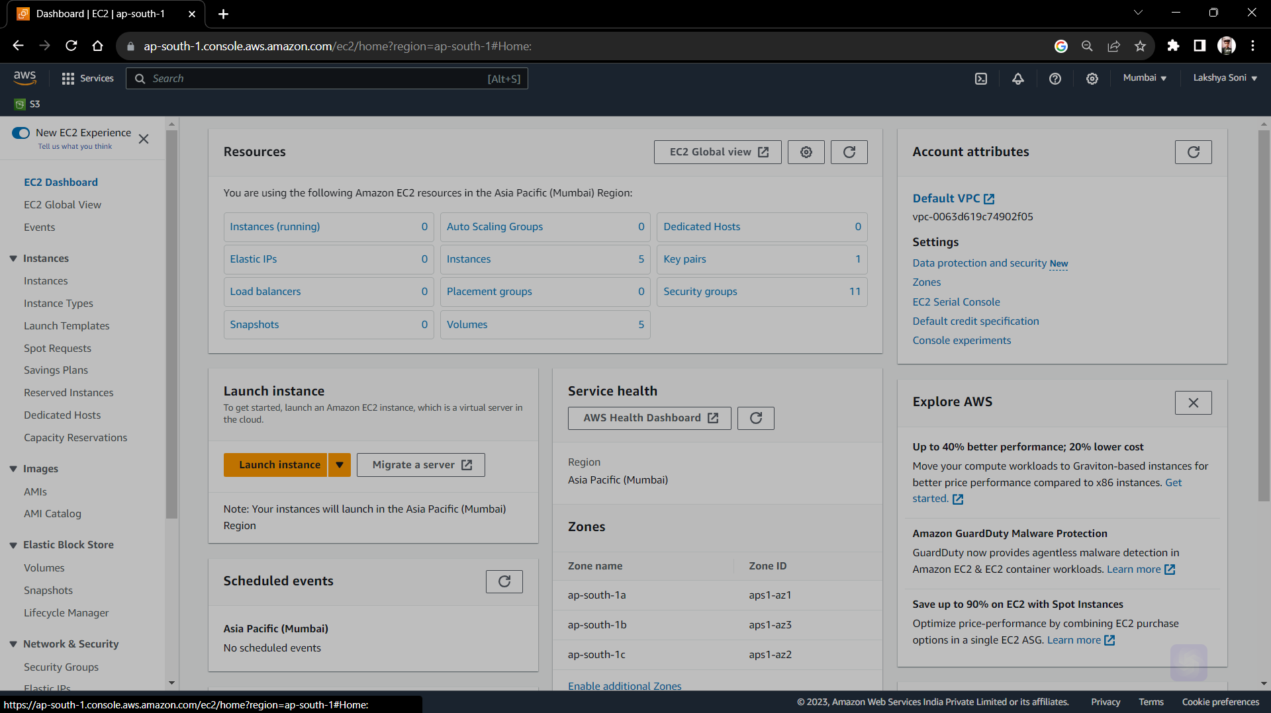
launch an ec2 instance

Slide 5
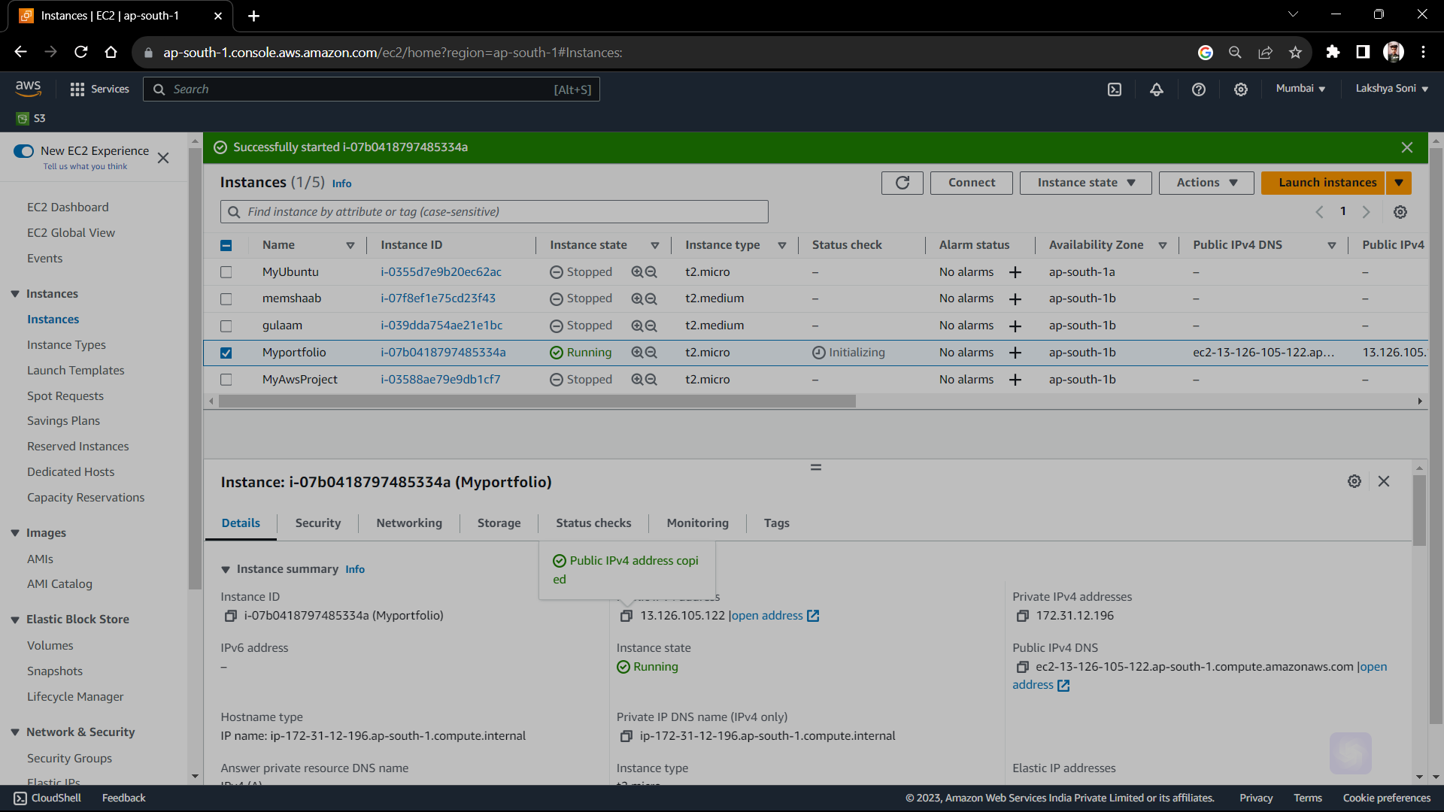

Slide 6
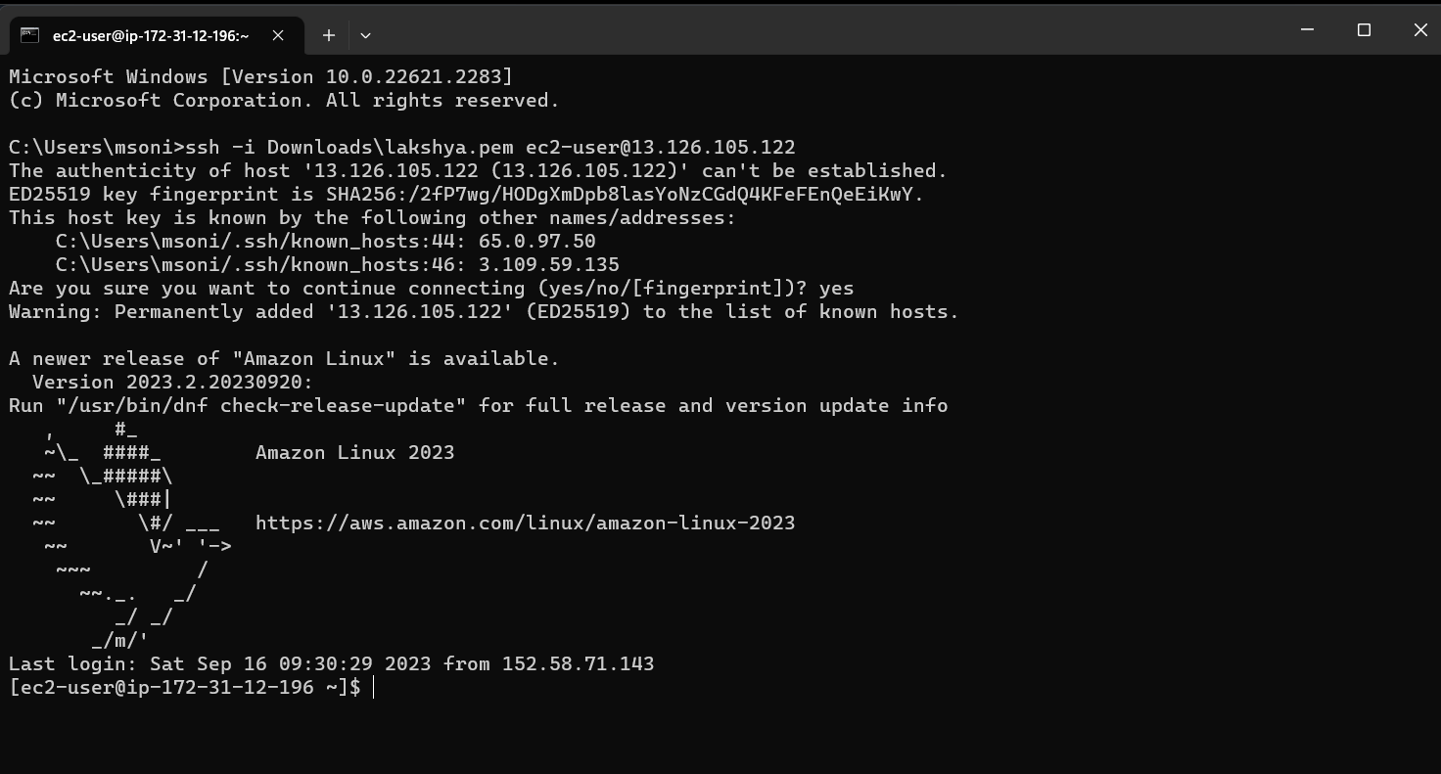
Connect ec2 instance with local host

Slide 7
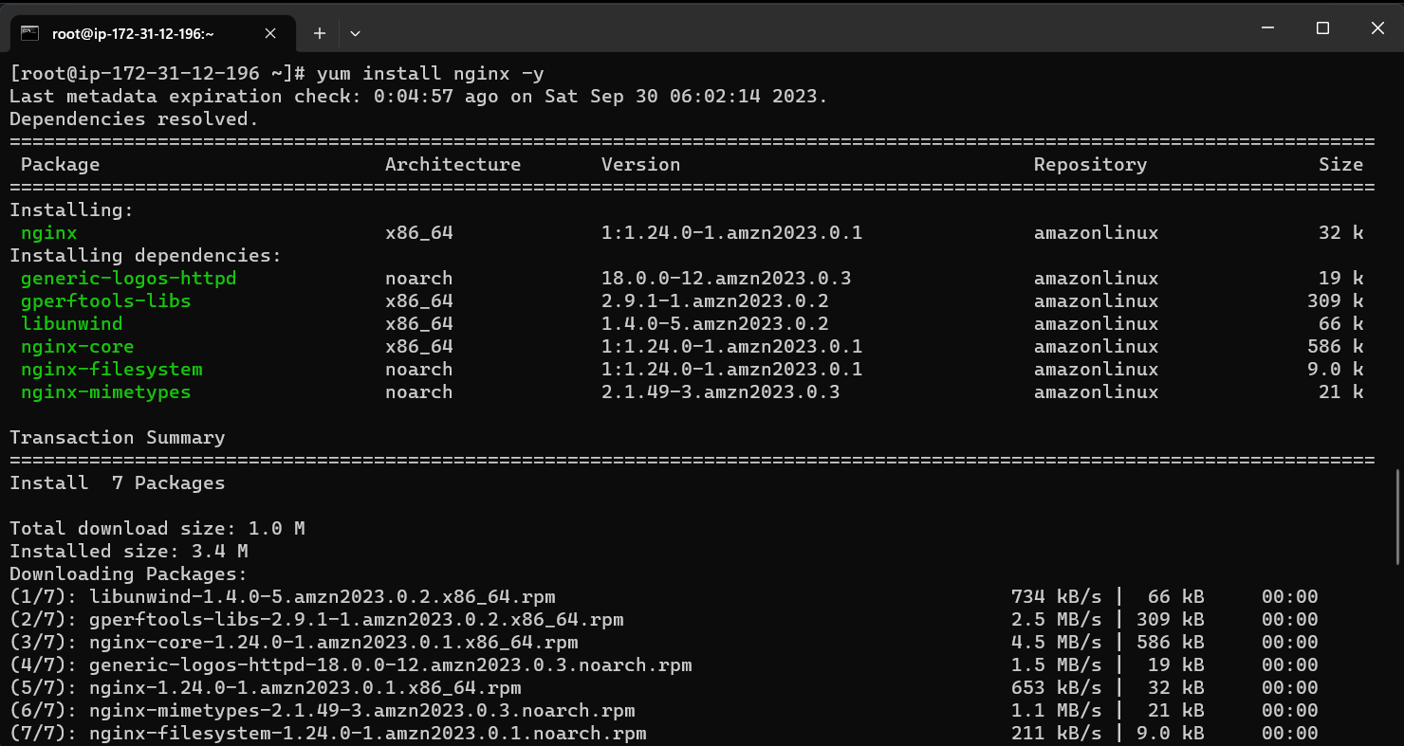
Install nginx server on ec2 instance

Slide 8
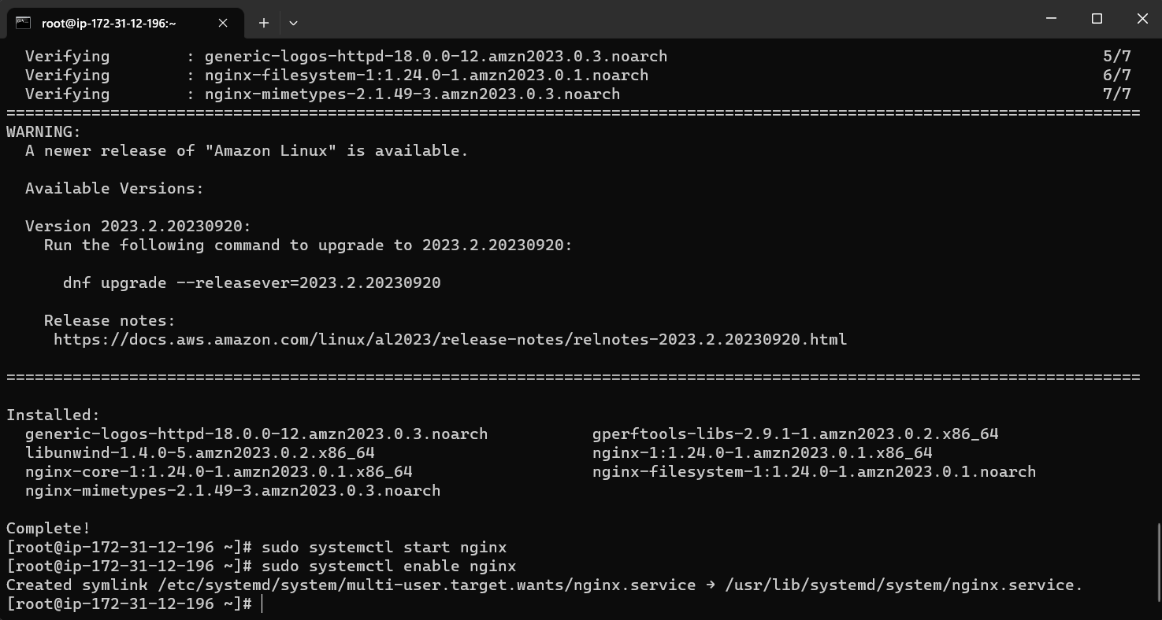
Enable nginx server

Slide 9
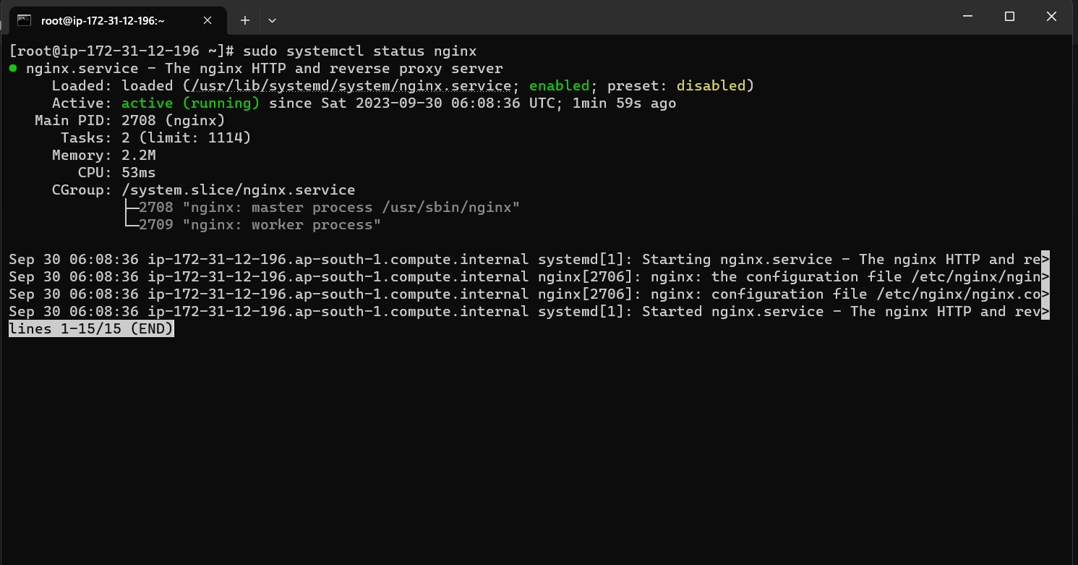
Checking status of nginx

Slide 10
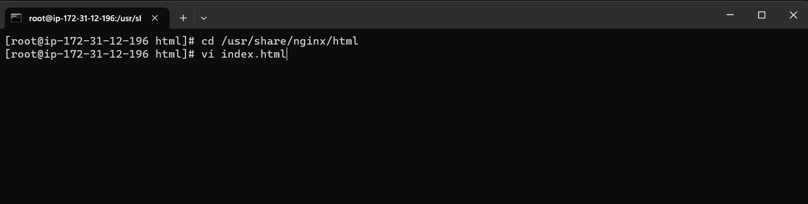
Now add files on server path

Slide 11
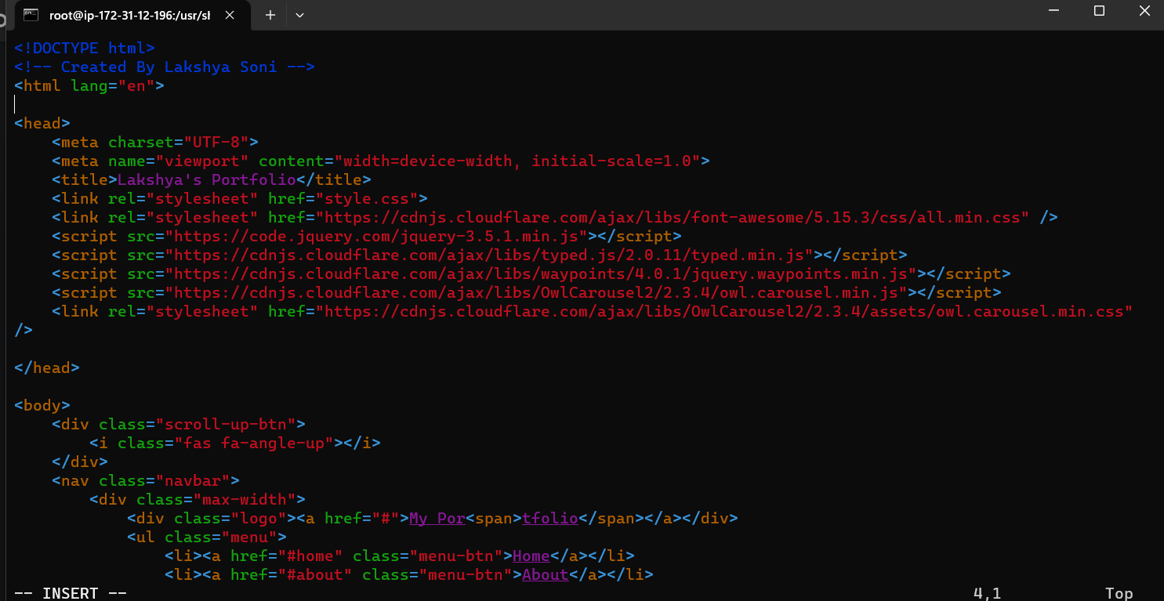
Index.html

Slide 12
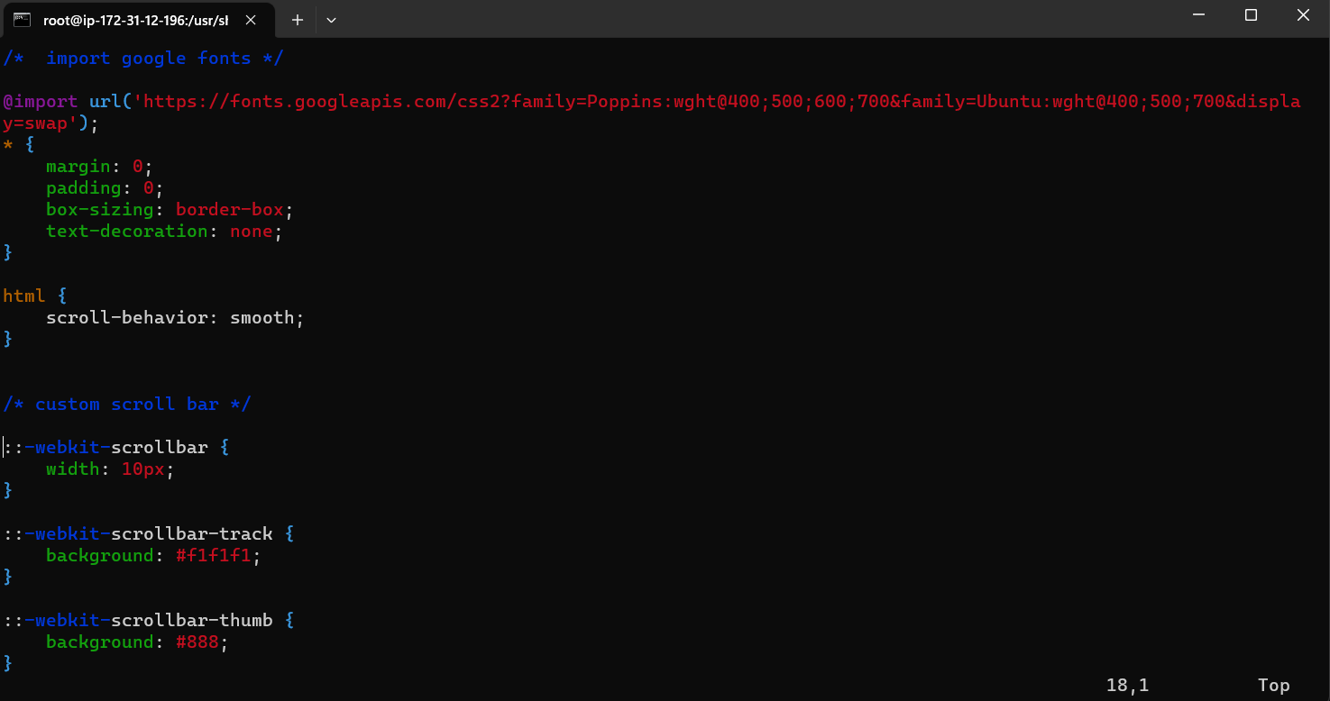
Style.css

Slide 13
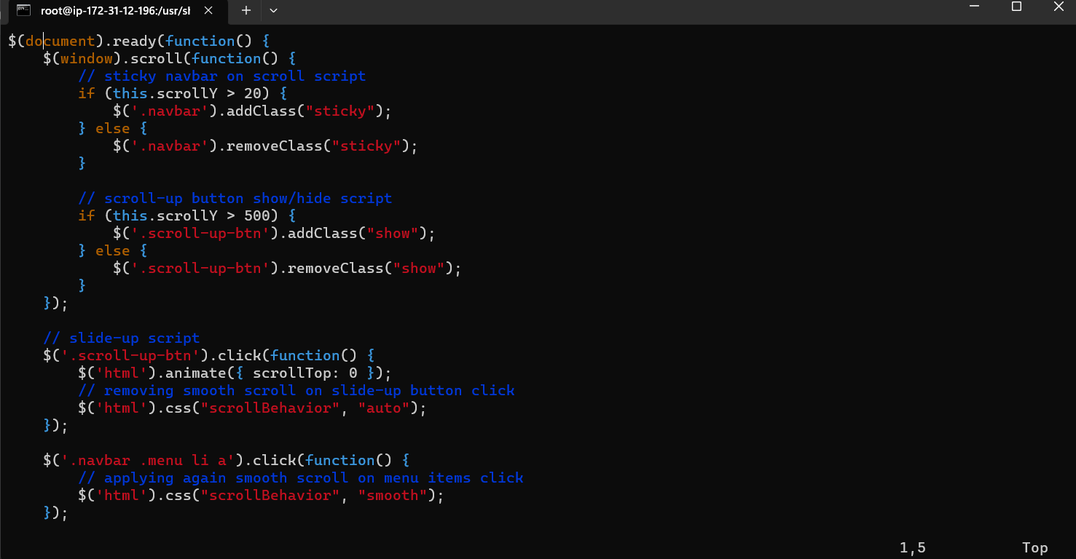
System.js

Slide 14
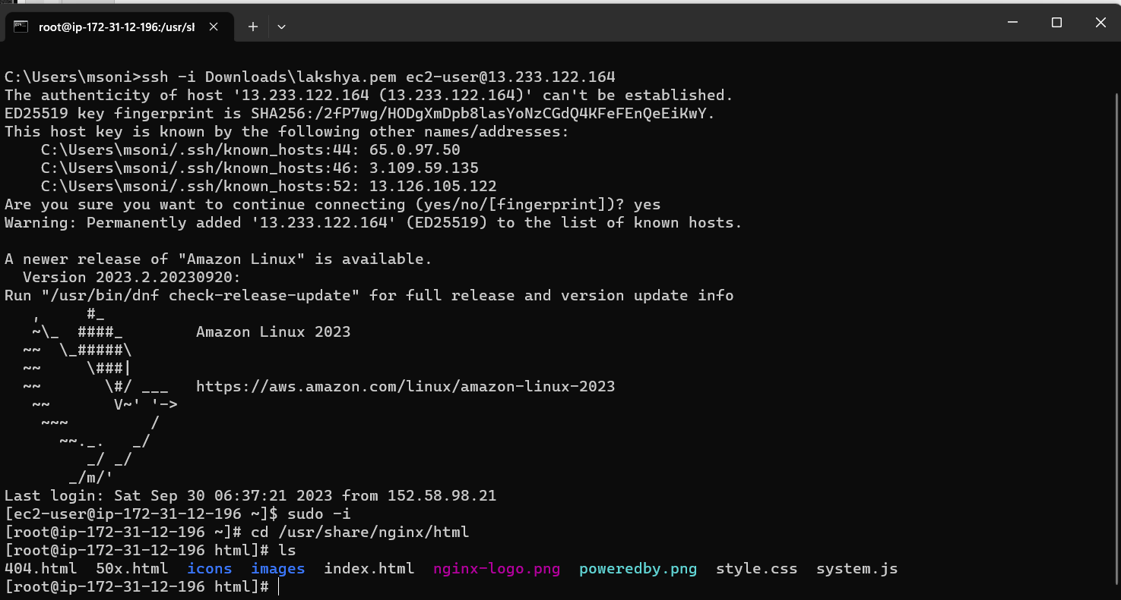
All files on ec2 instance

Slide 15

Access the webpage using public ip of instance

Slide 16


